Slide 1
Lipids: Fatty Acids and Triacylglycerols
1) Structure and Properties 2)Digestion, Absorption, and Transportation 3) Metabolism

Slide 2
Learning Objectives
Understand how fatty acids are synthesized in the body
Describe the initial highly regulated step of FA synthesis
Understand the reactions resulting in triacylglycerol synthesis resulting in 3 fatty acids esterified to glycerol
Describe the breakdown of triacylglycerol to glycerol plus fatty acids and the fates of these products
Describe fatty acid breakdown (beta-oxidation)
Determine the amount of energy produced by fatty acid breakdown in comparison to glucose
Understand when ketogenesis occurs, what organs ketones are a fuel source for and consequences of overactive ketogenesis

Slide 3
Lipogenesis
Fatty acid and triacylglycerol biosynthesis
FA synthesis → triacylglycerol synthesis→ storage

Slide 4
Overview of Lipogenesis

Slide 5
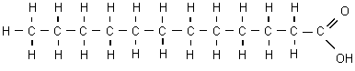
Synthesis of Fatty Acids (FA)
Reminder structure of FA:
Hydrocarbon chain, methyl end, carboxylic acid end
Main sites of biosynthesis: liver and adipose tissue

Slide 6
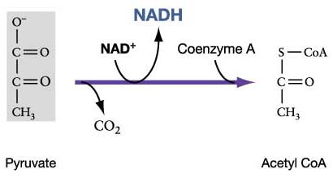
Synthesis of Fatty Acids (FA)
Biosynthesis of FAs from acetyl CoA (mitochondria)
Exceptions: essential linoleic and alpha-linolenic FAs
FA synthesis enzymes in cytoplasm
Acetyl CoA must relocate from the mitochondria to cytoplasm
Acetyl CoA:
First substrate of FA biosynthesis
Must relocate to cytoplasm
Pyruvate Dehydrogenase
Reaction (in mitochondria)

Slide 7
Synthesis of Fatty Acids
Acetyl CoA (and OAA) converted to citrate via Krebs
Citrate crosses mitochondrial membrane to cytoplasm
Citrate cleaved back to acetyl CoA (and OAA)
Acetyl CoA first substrate in FA biosynthesis
Citrate Synthase (mitochondria)
Citrate Lyase
(cytoplasm)
Acetyl CoA AND
Oxaloacetate
Acetyl CoA and
Oxaloacetate
Citrate
Mitochondria
Cytoplasm

Slide 8
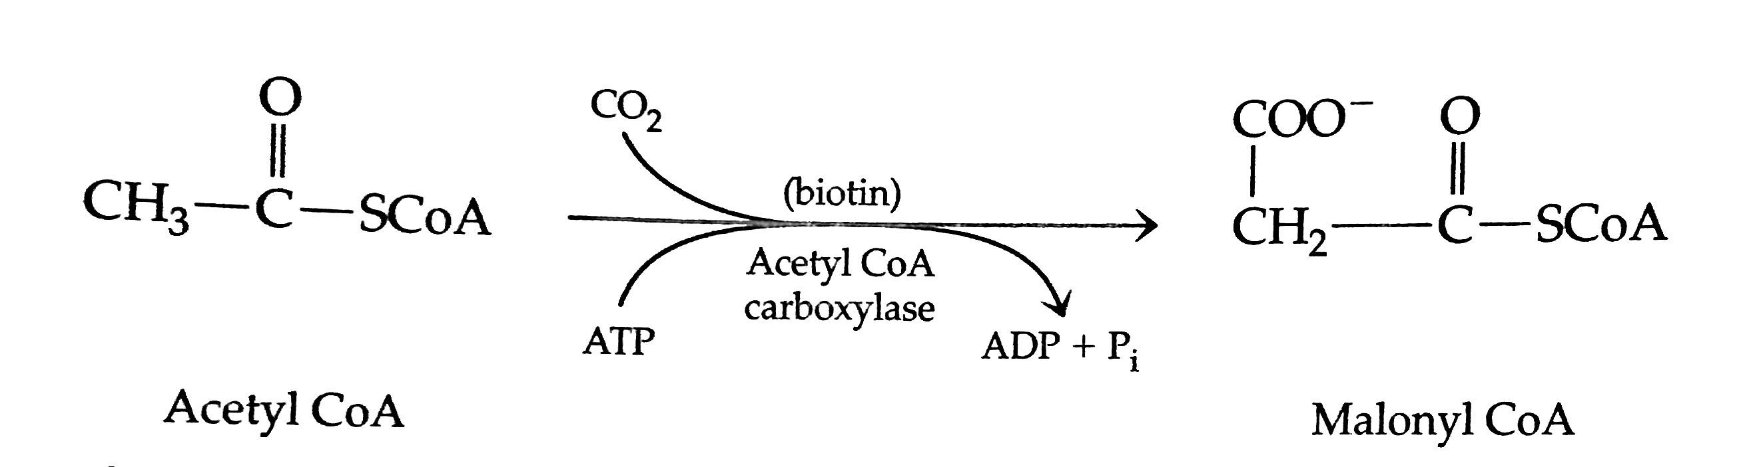
Synthesis of Fatty Acids
Initial Step:
Acetyl CoA → Malonyl CoA
Irreversible, highly regulated step of FA synthesis
Acetyl CoA present in cytoplasm stimulates reaction
Insulin increases transcription of acetyl CoA Carboxylase
Biotin and ATP required
Carboxyl group incorporated forming Malonyl CoA
Acetyl CoA Carboxylase

Slide 9
Synthesis of Fatty Acids
7 malonyl CoAs molecules created from Acetyl CoA
Acetyl CoA
Acetyl CoA Carboxylase
ATP
CO₂
x 7
ADP
Biotin
Malonyl CoA

Slide 10
Synthesis of Fatty Acids
Second/final step:
Substrates: 7 malonyl CoAs and 1 Acetyl CoA
Fatty acid synthase catalyzes series of reactions
2 carbons from malonyl CoA transferred to acetyl CoA
Newly added carbons are reduced
Repeat 6 more times by added carbons to newly growing chain
Results in a 16 carbon product: palmitate
2 carbon + (2 carbons)*7 = 16 carbons
Acetyl CoA + 7 Malonyl CoA →→→Palmitate (16 carbon FA)
FA Synthase
7 Malonyl CoA +
Acetyl CoA
Palmitate
2 NADPH x 7
2 NADP x 7

Slide 11
Synthesis of Fatty Acids
7 Acetyl CoA
Acetyl CoA Carboxylase
7 ATP
7 CO₂
7 ADP
+ P
Biotin
FA Synthase
7 Malonyl CoA +
Acetyl CoA
Palmitate
14 NADPH
14 NADP

Slide 12
Pentose Phosphate Shunt
Glucose 6-Phosphate
Glucose 6-phosphate dehydrogenase
NADP
NADPH
Lipid metabolic paths;
Glutathione reduction
6-Phosphogluconate
NADP
NADPH
Lipid metabolic paths;
Glutathione reduction
Ribulose 5-Phoshate
Isomerase
Conversion to Fructose 6-P for glycolysis
Ribose 5-Phoshate
Biosynthesis of nucleic acids and nucleotides (ATP, RNA, DNA, NAD, etc.

Slide 13

Synthesis of Fatty Acids
Final Product: Palmitate (C₁₆H₃₂O₂)
16 carbon saturated FA
Further lengthened by fatty acid elongation
systems
Desaturation reactions – convert saturated FA to
unsaturated FAs
Palmitate

Slide 14
Triglyceride Synthesis

Slide 15
Triacylglycerol Synthesis
Mainly synthesized in liver and adipose tissue
First substrates of triacylglycerol biosynthesis include:
Fatty acid acyl-CoA
Fatty Acid + CoA + H20 → Fatty acid acyl CoA
Glycerol 3-phosphate
DHAP
O
||
(Fatty acid-C-CoA)

Slide 16
Triacylglycerol Synthesis
Step 1: Two fatty acyl groups (FA-C-CoA) transferred to glycerol 3-P to form diacylglycerol 3-P
O
||
O
||
Acyl group = FA-C-CoA
Acyltransferases
Glycerol 3-phosphate
Phosphatidic acid
(diacylglycerol 3-phosphate)
2 Fatty acid acyl-CoA
2 CoA

Slide 17
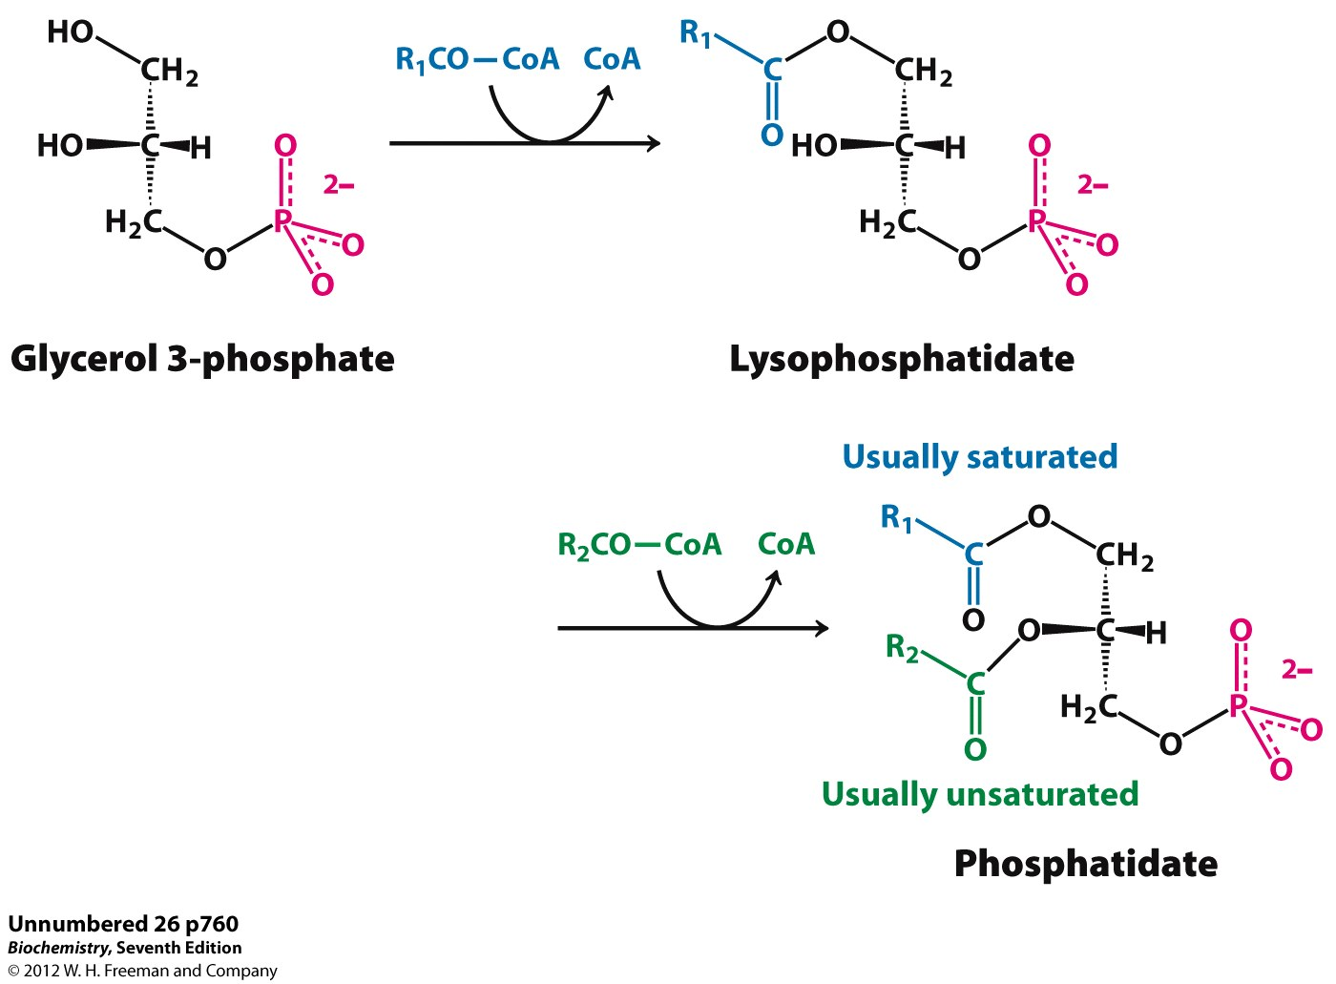
Step 1: Triacylglycerol Synthesis: 2 fatty acyl groups added
Fatty Acid
Step 1: Acyl groups (R-C=O) transferred to glycerol 3-P to form a diacylglycerol
Ester Bond
Hydroxyl group of glycerol reacts with fatty acyl group
Phosphatidic acid
(diacylglycerol 3-P)

Slide 18
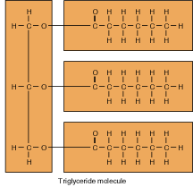
Phosphatidic acid
(diacylglycerol 3-P)
Triacylglycerol

Slide 19
Triacylglycerol Synthesis
Step 2: Dephosphorylation of diacylglycerol 3-P and final fatty acid acyl transfer
Acyltransferase and phosphatase
Phosphatidic acid
(diacylglycerol 3-P)
Triacylglycerol
Fatty acyl-CoA
CoA
P

Slide 20
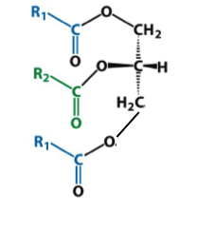
Step 2: Triacylglycerol Synthesis: Dephosphorylation and a fatty acyl groups added
3
Phosphatidic acid
(diacylglycerol 3-phosphate)
3
P
Triacylglycerol

Slide 21
3
Triacylglycerol
Triacylglycerol

Slide 22
Triacylglycerol Fate
Major destination is adipose tissue for storage
Incorporated into VLDL in liver
Exported from liver through circulation via VLDL

Slide 23
Summary
Fatty Acid Synthesis
Triacylglycerol Synthesis
Initial reaction: acetyl CoA converted to malynol CoAs
Highly regulated
7 Malynol CoA transfers 2 carbons to Acetyl CoA
Palmitate is final product (16-carbon FA)
Palmitate can be further elongated or desaturated
Two fatty acyl CoAs transfer acyl group to glycerol 3-phosphate
Resulting diacylglycerol 3-P is dephosphorylated and fatty acyl donates final acyl
Triacylglycerol is formed
Triacylglycerol is likely stored in adipose tissue until needed

Slide 24
Breakdown of triacylglycerol Into Glycerol and fatty acids
Lipolysis

Slide 25
Why?

Slide 26
Triacylglycerol Breakdown
Fuel source for tissues in fasting conditions
Brain and RBC can not utilize lipids as energy source
Hormones involved in hydrolysis of triacylglycerol
Lipoprotein lipase – active in liver
Hormone sensitive lipase – active in adipose tissue
Mobilizes fats from storage
Activated by low insulin
Hydrolysis of triacylglycerol yields: Glycerol and 3 fatty acids
Notes:
\

Slide 27
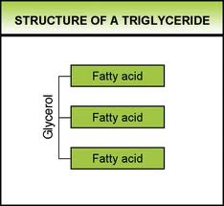
Triacylglycerol Breakdown
Hydrolysis of triacylglycerol yields two products:
Glycerol
3 fatty acids
Glycerol product – used for energy source
Converted to glycerol phosphate via glycerol kinase
Enters glycolysis or gluconeogenesis as DHAP

Slide 28
Triacylglycerol Breakdown
GK or
Glucose
G-6-P
F-6-P
F-1,6-BP
Triacylglycerol
HK
PFK
G6P
3 FA
Beta-oxidation
Glycerol
F1,6-
BP
Glycerol Kinase
GA3P
PEP
Pyruvate
DHAP
Glycerol
Phosphate
PK

Slide 29
Triacylglycerol Breakdown
Triacylglycerol breakdown yields:
Glycerol
3 fatty acids
Source of energy in fasted states
Fatty acid products enter circulation for other tissues

Slide 30
Fatty Acids
Fatty acids products– richer source of energy than CHOs
Exist in a more reduced state – undergo greater extent of oxidation
Mechanism of fatty acid oxidation: Beta-oxidation
Occurs in mitochondria of many cell types

Slide 31
Fatty Acid Oxidation

Slide 32
Fatty Acid Breakdown
Glucose
G-6-P
F-6-P
F-1,6-BP
Triacylglycerol
Beta-oxidation
3 FA
Glycerol
Glycerol Kinase
Reducing equivalents
enter ETC
GA3P
PEP
Pyruvate
DHAP
Glycerol
Phosphate
Krebs Cycle
AcetylCoA
ETC

Slide 33
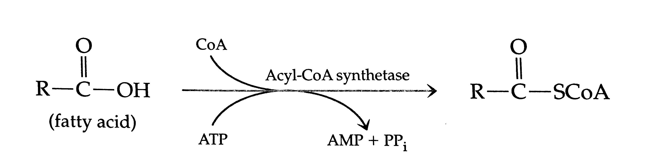
Fatty Acid B-oxidation
Initial reaction converts fatty acid to fatty acid acyl-CoA (cytoplasm) (energy utilization – 2 phosphates)
Fatty acid acyl CoA is transported from the cytoplasm to mitochondria for B-oxidation
Via transport system: Carnitine transport system

Slide 34
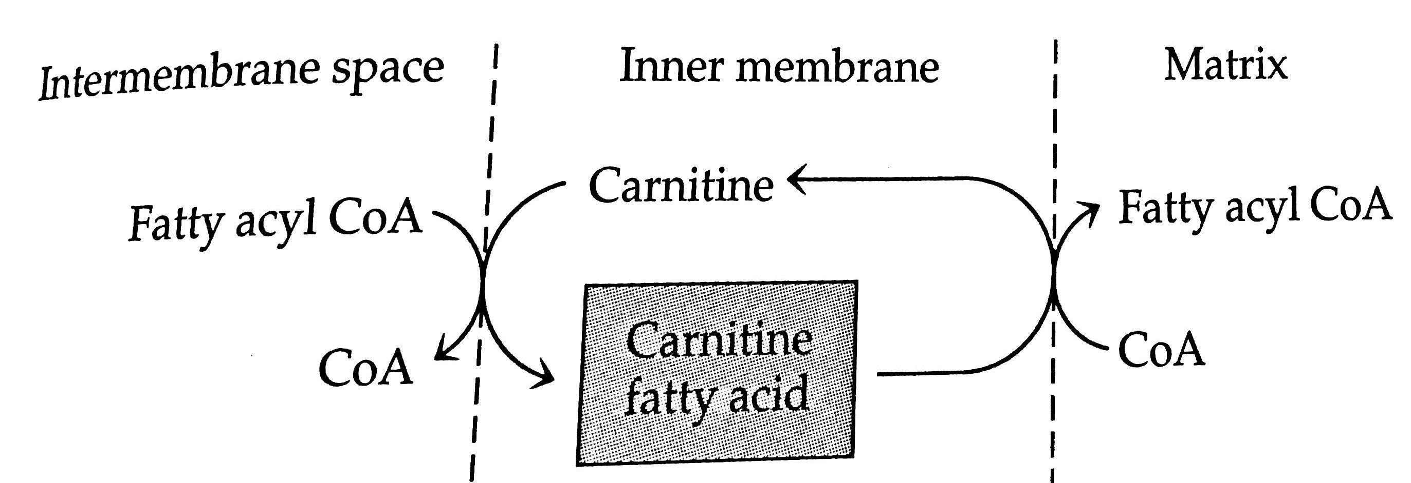
Fatty Acid B-oxidation
Carnitine transport system:
Uses carnitine as a carrier molecule
Carnitine moves fatty acyl CoA from cytoplasm across mitochondrial membrane to mitochondria
Enzymes: Carnitine Palmitoyltransferase 1 (CPT1) and CPT2
CPT1 is negatively modulated by Malonyl CoA
CPT1
Mitochondrial Membrane
Cytosol
Mitochondria
CPT2

Slide 35
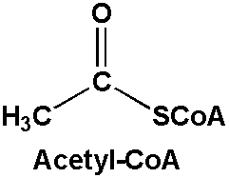
Fatty Acid B-oxidation
Fatty acyl CoA in mitochondria
Overall: Acetyl CoAs (2 carbon units) cleaved from the carboxyl ends of FA
4 main reactions
Palmitate (16 carbon FA) as an
example

Slide 36
Fatty Acid B-oxidation
Reaction 1: Acyl CoA dehydrogenase forms a double bond between alpha and beta carbons of fatty acid
O
||
CH3-(CH2)12-CH2-CH2-C-SCoA
FAD
Fatty Acyl CoA dehydrogenase
Electron Transport Chain
O
||
CH3-(CH2)12-CH=CH-C-SCoA
FADH2

Slide 37
Fatty Acid B-oxidation
Reaction 1:
FADH₂ enters ETC to yield 2 ATP

Slide 38
Fatty Acid B-oxidation
Reaction 2: molecule of water enters - forming a hydroxy group on beta carbon
O
||
CH₃-(CH₂)₁₂-CH=CH-C-SCoA
H20
Enoyl CoA hydratase
HO O
| ||
CH₃-(CH₂)₁₂-CH-CH₂-C-SCoA

Slide 39
Fatty Acid B-oxidation
Reaction 3: Hydroxy group oxidized
NAD is reduced to NADH + H and enters ETC
HO O
| ||
CH3-(CH2)12-CH-CH2-C-SCoA
NAD
Beta-hydroxyacyl CoA dehydrogenase
Electron Transport Chain
NADH
+ H
O O
|| ||
CH3-(CH2)12-C-CH2-C-SCoA

Slide 40
Fatty Acid B-oxidation
Reaction 1:
FADH₂ enters ETC to yield 2 ATP
Reaction 3:
NADH enters ETC to yield 3 ATP

Slide 41
Fatty Acid B-oxidation
Reaction 4: cleavage to a FA and Acetyl CoA
Acetyl CoA enters Krebs for oxidation
O O
|| ||
CH3-(CH2)12-C-CH2-C-SCoA
CoA
Acetyltransferase
O O
|| ||
CH3-(CH2)12-C-SCoA + CH3-C-SCoA
Acetyl CoA

Slide 42
Fatty Acid B-oxidation
Repeat Reactions 1-4 until reduced to all 2-carbon units (acteyl CoA)

Slide 43
Fatty Acid B-oxidation Summary: Important Slide!
Two high-energy phosphates required (initial reaction when fatty acid acylCoA is created) – only happens once
Reaction 1-4 repeated until FA is completely broken down
Cleave of 2 carbons each cycle: acetyl CoA as product
Each cycle produces:
2 ATP from FADH2 – enters ETC
3 ATP from NADH – enters ETC
1 Acetyl CoA – can enter Krebs to be oxidized (12 ATP per Acetyl CoA)
Notes:
7x2 = 14
7x3 = 21
8x12 = 96
- 2 atp -2 = 129 ATP

Slide 44
Beta-Oxidation
Glucose
G-6-P
F-6-P
F-1,6-BP
Triacylglycerol
Beta-oxidation
3 FA
Glycerol
Glycerol Kinase
Reducing equivalents
enter ETC
Glycerol
Phosphate
GA3P
PEP
Pyruvate
DHAP
Acetyl CoA
Krebs Cycle
ETC

Slide 45
Fatty Acid B-oxidation Activity
Think of palmitate – Seven 2-carbon cleavages
Remember:
2 high-energy phosphates required (initial irreversible reaction) – equivalent to 2 ATP
Cycle – reduced by 2 carbons each cycle
Each cycle produces:
2 ATP from each FADH
3 ATP from each NADH
Acetyl CoA (8 total from palmitate) – can enter Krebs to be oxidized
Acetyl CoA produces 12 ATP per Krebs

Slide 46
Activity - Palmitate (16 carbon FA)
CH3-CH2-CH2-CH2-CH2-CH2-CH2-CH2-CH2-CH2-CH2-CH2-CH2-CH2-CH2-C=O(CoA)
# ATP lost from initial reaction:
# ATP gained from FADH:
# ATP gained from NADH:
# ATP gained from Acetyl CoA:
Net ATP:

Slide 47
Activity - Palmitate (16 carbon FA)
CH3-CH2-CH2-CH2-CH2-CH2-CH2-CH2-CH2-CH2-CH2-CH2-CH2-CH2-CH2-CH2-C=O(CoA)
# ATP lost from initial reaction: -2
# ATP gained from FADH: 14
# ATP gained from NADH: 21
# ATP gained from Acetyl CoA: 96 (12 x 8)
Net ATP: 129
Versus complete oxidation of one glucose unit: 38 ATP

Slide 48
Fatty Acid B-oxidation
Unsaturated fatty acids
Oxidized in nearly identical fashion
One fatty acyl dehydrogenase not required
Double bond introduced occurs naturally in unsaturated
Bypasses FADH2 producing step
O
||
CH3-(CH2)12-CH2-CH2-C-SCoA
FAD
Reaction 1
Acyl CoA dehydrogenase
O
||
CH3-(CH2)12-CH=CH-C-SCoA
FADH2

Slide 49
Fatty Acid B-oxidation
Odd-numbered Fas
What about a 17-carbon FA?!
Seven 2-carbon cleavages but what do we do with the last 3 carbons?
Final products include:
1 Acetyl CoA and 1 Propionyl CoA (3 carbon)
Propionyl CoA → → Succinyl CoA
Succinyl CoA – enter Kreb’s as an intermediate

Slide 50
Ketogenesis

Slide 51
Ketogenesis Overview
Acetyl CoA production accelerated from B-oxidation
Fasting, low CHO conditions
Can enter ketogenesis
Ketogenesis produces ketone bodies
Acetoacetate
Beta-hydroxybutyrate
Acetoacetate and B-hydroxybutyrate transported to tissues to be oxidized (Krebs)

Slide 52
Ketone Bodies
Typical individuals have low level of ketone bodies in circulation at any given time
We can utilize ketone bodies as an energy source efficiently
Ketogenesis: 2 acetyl CoA → Ketone Bodies
Mainly occurs in liver
Ketones do not stay in liver because it lacks enzyme for initial reaction of ketone body oxidation
Ketone body oxidation: ketone bodies → acetyl CoA
Brain, heart, muscle, etc.
Acetyl CoA enters Krebs

Slide 53
Ketogenesis – fasting, low CHO conditions
1. Increased Production
Glucose
G-6-P
F-6-P
F-1,6-BP
Triacylglycerol
G6P
1. Increased
Beta-oxidation
Gluconeogenesis
3 FA
F1,6-
BP
GA3P
PEP
Pyruvate
2. Decreased Supply
OAA
2. Surplus with limited OAA
Acetyl CoA
Krebs Cycle
Ketogenesis
Notes:
Glyceraldehyde 3 phosphate

Slide 54
Ketoacidosis
Build up of ketone bodies: ketoacidosis
Coma, dehydration, excessive urination, vomiting, organ failure
Conditions in which build up could occur
Untreated type 1 and type 2 diabetes: Low levels of circulating insulin
Type 1 – beta cells cannot make insulin
Type 2 – beta cells are damaged from prolonged periods of overproduction of insulin
Starvation, very low CHO diet
Beta-oxidation is accelarated – lots of acetyl CoA produced
Gluconeogenesis accelerated
Reduced pool of OAA (oxaloacetate) – intermediate is exhausted for glucose production
Acetyl CoA enter alternative pathway

Slide 55
Lipolysis Summary
Triacylglycerol broken down to its main constituents – glycerol and fatty acids
Glycerol enters glycolysis pathway as glycerol phosphate
Fatty acid broken down by B-oxidation producing more energy than oxidation of one glucose (occurs in mitochondria)
Under fasting/low carb conditions ketogenesis produces ketone bodies for energy
Under extreme ketogenic conditions ketoacidosis occurs

Slide 56
Lipids: Cholesterol, Lipoproteins, and PUFAs
1) Structure and Properties 2)Digestion, Absorption, and Transportation 3) Metabolism

Slide 57
Learning Objectives
Identify the functions of cholesterol within our body
Understand that cholesterol homeostasis is highly regulated in the body
Describe the 3 main steps of cholesterol synthesis
Describe the main carriers of cholesterol throughout the body
Understand the etiology of “high” cholesterol and its potential role in atherosclerosis
Understand why some unsaturated fatty acids are essential
Describe the different functions of omega-3 and -6 derivatives
Identify the sources of omega-3 and -6 and their derivatives

Slide 58
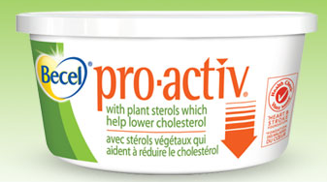
Cholesterol
Sterol family
Plant sterols
Cholesterol – animal products
Plant sterols interfere with cholesterol absorption

Slide 59
Cholesterol
Dietary intake plus biosynthesis of cholesterol is about 1 g/day
US intake estimated around 300-600 mg/day (0.3g/day)
Biosynthesis accounts for up to 60-70% of total daily cholesterol
Highly regulated
Mainly in liver, but can occur in all nucleated cells

Slide 60
Functions of Cholesterol
Cell membranes – >90% of cholesterol found in cell membranes
Steroid hormones – estrogen, progesterone, testosterone, glucocorticoids, androgens, mineralocorticoids (aldosterone)
Vitamin D – synthesis in the skin from ultraviolet rays
Bile – aides in lipid and fat-soluble vitamin absorption

Slide 61
Cholesterol Biosynthesis
At least 26 steps of cholesterol synthesis
3 stages:
3 Acetyl CoA → → 3-hydroxy-3methylglutaryl CoA (HMG CoA)
HMG CoA → mevalonic acid →→ Squalene
Squalene → →Cholesterol
HMG CoA Reductase

Slide 62
Cholesterol Biosynthesis
3 Acetyl CoA →→ 3-hydroxy 3-methylglutaryl CoA (HMG CoA)
- Condensation of 3 acetyl CoA
HMG CoA → mevalonic acid →→ Squalene
- HMG CoA reductase is rate limiting step
- As mevalonic acid increases, it inhibits HMG CoA reductase
HMG CoA Reductase

Slide 63
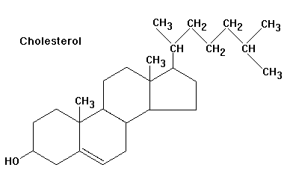

Cholesterol Biosynthesis
Squalene →→ Cholesterol
Squalene goes through series of cyclization reactions – to produce 4 ring core (steroid nucleus)
As intracellular cholesterol increases, it inhibits HMG CoA reductase
→→

Slide 64
Cholesterol Biosynthesis Regulation
Negative feedback system of mevalonic acid and endogenous cholesterol on HMG CoA reductase
Dietary intake of cholesterol suppresses production only in liver
Cholesterol

Slide 65
Lipoprotein
Lipoprotein – transport vehicle for lipids
Important in transportation of dietary and endogenous cholesterol
Four main types- distinguished by size and density
Chylomicrons – dietary cholesterol
Very low density lipoprotein (VLDL)
Low density lipoprotein (LDL)
High density lipoprotein (HDL)

Slide 66
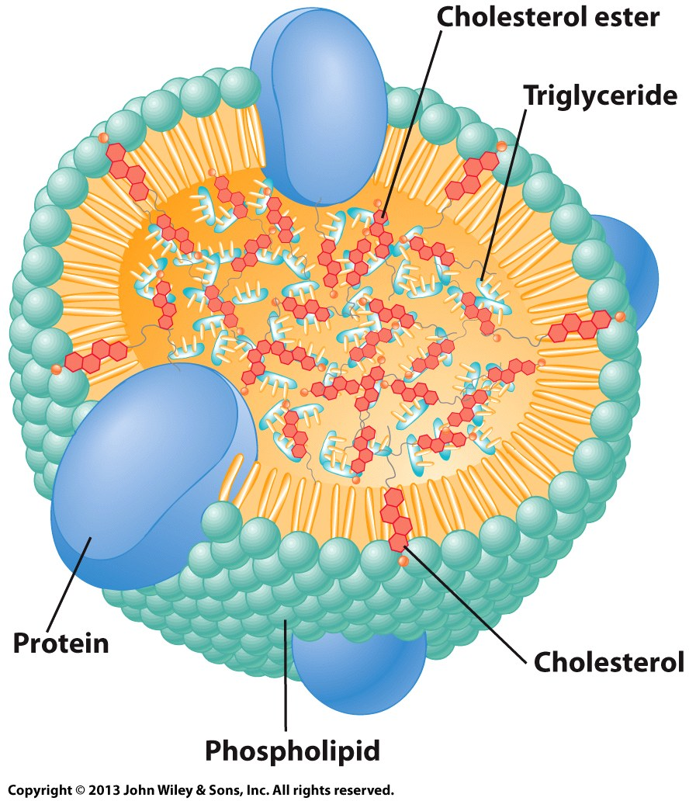
Lipoproteins
Apolipoprotein
General Structure of Lipoproteins:
Hydrophobic lipids in core
Surrounded by phospholipids and apolipoproteins
Apolipoprotein
Apolipoprotein
Apolipoprotein

Slide 67
Lipoprotein
Chylomicron: transporter of dietary cholesterol and other lipids (e.g., triacylglycerols) from enterocyte
Lowest density of 4 lipoproteins
Richest in triacylglycerol
Re-esterfied lipids (from diet) packaged into core of chylomicrons
First destination muscle and adipose tissue

Slide 68
Lipoprotein
At muscle and adipose tissue
Lipoprotein lipase (LPL) activated by ApoC
LPL hydrolyzes fatty acids from triacylglycerol
Fatty acids enter tissues
Product of LPL is called a chylomicron remnant: Cholesterol rich
Chylomicron remnant travels to liver

Slide 69
Lipoprotein Metabolism
Chylomicron remnant rich of cholesterol esters enters liver
Cholesterol esters plus endogenous cholesterol and triacylglycerol reincorporate into VLDL
VLDL - Cholesterol esters and cholesterol (and some endogenous triacylglycerol)
Transporter out of liver
Contains apoB-100, apoC, and apoE

Slide 70
FA
FA
Adipose Tissue
Muscle
FA
FA
FA
FA
FA
FA
Small Intestine
LPL
LPL
Chylomicron Remnant (cholesterol rich)
Chylomicron
Chylomicron
Liver
VLDL (cholesterol and endogenous triacylglycerol)

Slide 71
Lipoprotein Metabolism
VLDL travels to adipose tissue and muscle
Lipoprotein lipase (LPL) activated by ApoC
LPL hydrolyzes triacylglycerol resulting in IDL
Travels to liver OR continues to decrease in triacylglycerol to become LDL
VLDL → IDL → LDL

Slide 72
Low-Density Lipoprotein (LDL)
LDL is major carrier of cholesterol through circulation
LDL transports to various tissues
Still contains apoB-100, apoC, and apoE
LDL receptors (LDLR) of tissue respond to apoB-100 and apoE
LDLRs found in majority of tissues

Slide 73
FA
FA
Muscle
FA
Adipose Tissue
FA
FA
FA
FA
FA
FA
Small Intestine
LPL
LPL
Chylomicron Remnant (cholesterol rich)
Chylomicron
Chylomicron
Tissue
Tissue
LDLR
LDLR
Tissue
LDLR
Liver
VLDL (cholesterol and endogenous triacylglycerol)
LDL (cholesterol rich)
IDL (cholesterol rich, very little triacylglycerol)
VLDL (cholesterol and endogenous triacylglycerol)
LDLR

Slide 74
Low-Density Lipoprotein (LDL)
LDLR – 5 domains
Example of domains functions:
Domain 1: cysteine rich domain – negatively charged to bind positively charged apoB-100 and apoE
Domain 3: rich in hydrophobic amino acids– high affinity for lipids

Slide 75
Low-Density Lipoprotein (LDL)
Number of LDLRs synthesized varies according to cholesterol levels
LDL binds to LDLR
Internalized by endocytosis
LDL enters into lysosome of cell
LDL hydrolyzed to AAs, FFAs, and free cholesterol
Free intracellular cholesterol modulates activity of:
HMG CoA reductase – suppression
Enzyme involved in cholesterol synthesis

Slide 76
LDLR Mutations
Cells unable to bind LDL via LDLRs (mutant cells)
Mutant cells – defect of chromosome 19
110 mutations effecting differing domains of LDLR
Broad term called Familial Hypercholesterolemia
1 in 500 carry at least one mutation
Emily C. O’Brien, PhD, et al.Rationale and design of the familial hypercholesterolemia foundation CAscade SCreening for Awareness and DEtection of Familial Hypercholesterolemia registry. American Heart Journal. 167:3. March 2014

Slide 77
LDLR Mutations
Physiological outcomes:
Altered synthesis of LDLRs results in abnormal levels and functioning of receptors at cell membrane
Accelerated biosynthesis of cholesterol – HMG CoA reductase remains activated
Results in high LDL levels in blood
Diet can be contributing factor to high serum LDL
Controlled by drugs, dietary restrictions, exercise
Statins - class of drugs inhibiting HMG CoA reductase

Slide 78
High Density Lipoprotein (HDL)
No system to breakdown cholesterol
HDL produced in liver
Transports cholesterol from non-hepatic tissue and circulation to the liver, gonadal, and adrenal tissues
Synthesis of cholesterol containing compounds and excretion via bile (feces)
Contains apoE and apoA-1

Slide 79
High Density Lipoprotein (HDL)
HDL functions:
Ability to bind to SR-B1 (apoA-1) receptor and LDLR on liver and non-liver tissue
HDL contains apoE and apoA-1
LDLR recognizes apoB-100 and apoE
Stimulates lecithin: cholesterol acyltransferase (LCAT)
Cholesterol ester molecule moves into the core of HDL

Slide 80
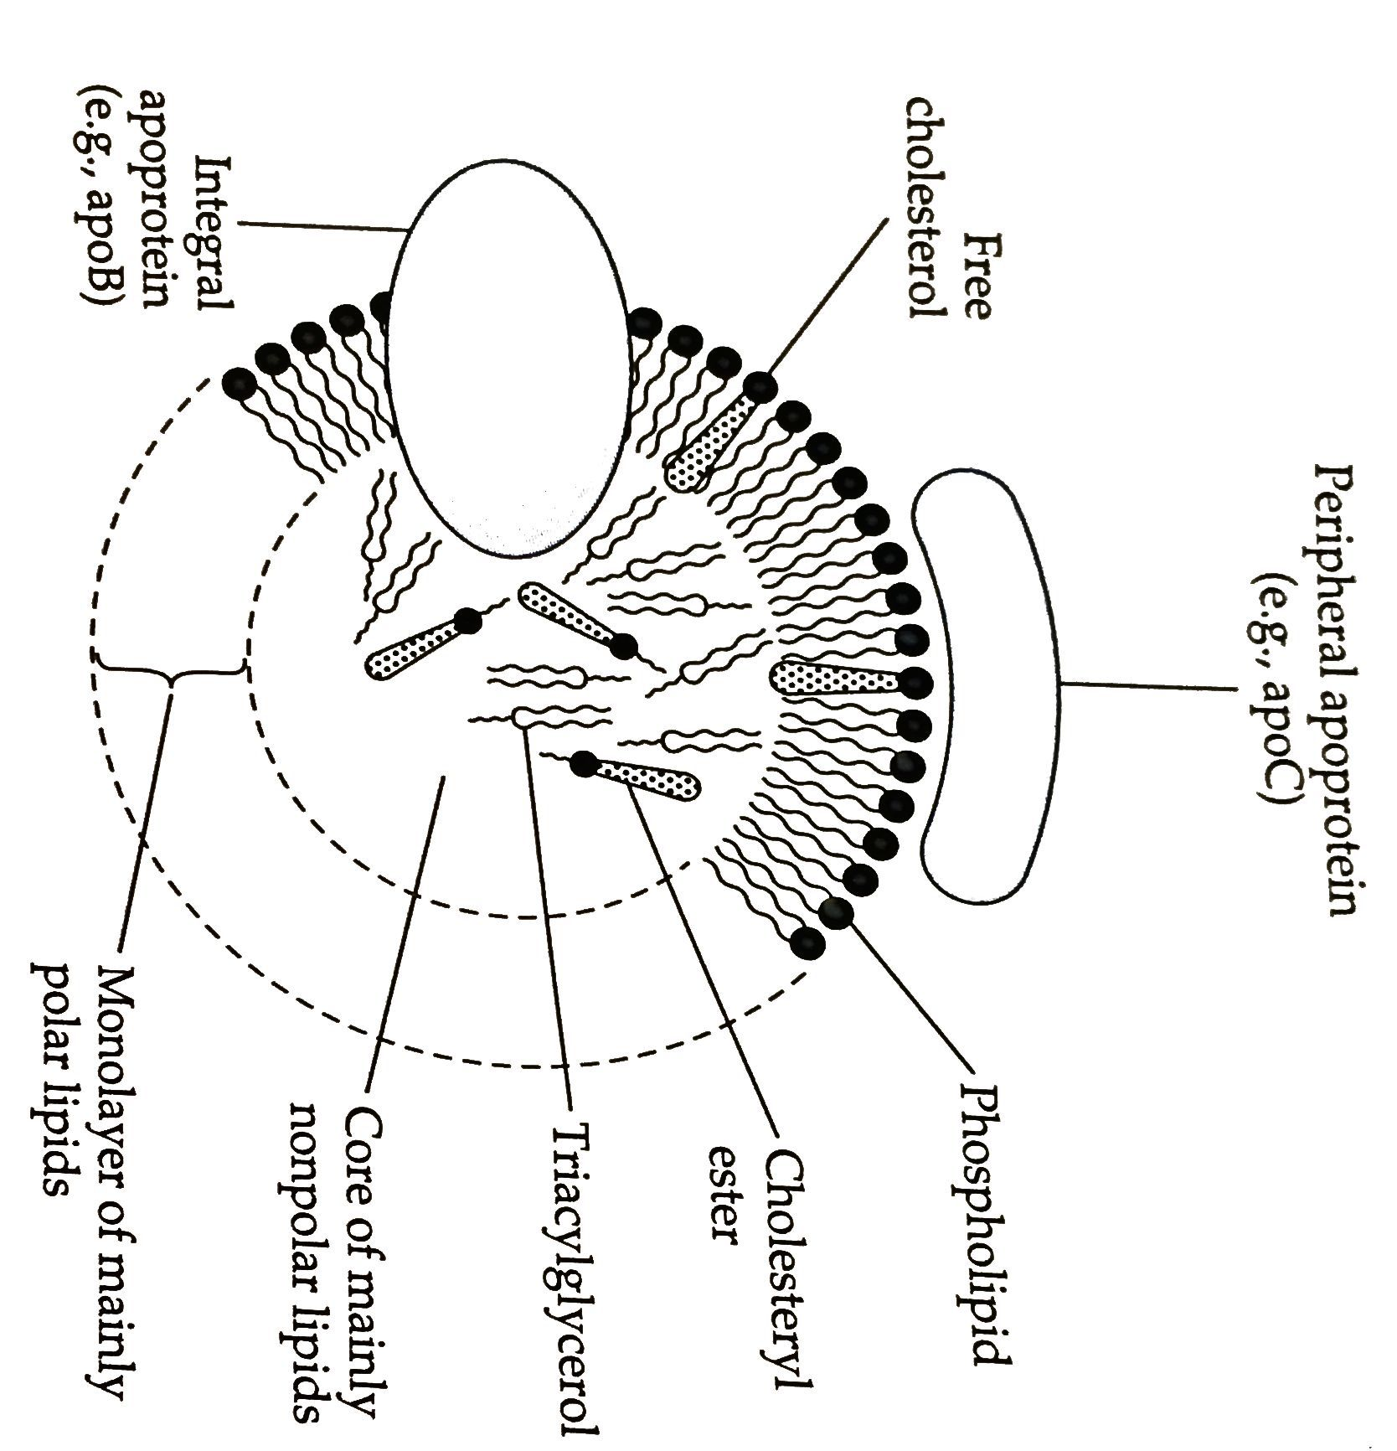
High-Density Lipoprotein (HDL)
HDL can remove cholesterol from LDL in circulation

Slide 81
FA
FA
Muscle
FA
Adipose Tissue
FA
FA
FA
FA
FA
FA
Small Intestine
LPL
LPL
Chylomicron Remnant (cholesterol rich)
Chylomicron
Chylomicron
Tissue
Tissue
Tissue
HDL
Liver
VLDL (cholesterol and endogenous triacylglycerol)
LDL (cholesterol rich)
IDL (cholesterol rich, very little triacylglycerol)
VLDL (cholesterol and endogenous triacylglycerol)

Slide 82
High-Density Lipoprotein (HDL)
Health benefits of removal of cholesterol from non-hepatic tissue and reducing circulating cholesterol by removing free cholesterol from LDL
- Transports cholesterol to other tissue
Liver: bile for excretion
Adrenal and gonadal: steroid hormones
High HDL levels associated with reduced risk of CVD

Slide 83
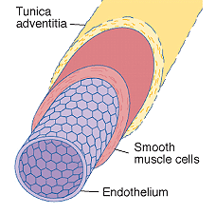
Lipid and Cardiovascular Disease Risk
Atherosclerosis – type of cardiovascular disease (CVD)
Degenerative disease of vascular endothelium – plaque build-up
Immune response from cell injury + lipid material
Vascular endothelium – space between blood flow and blood vessel

Slide 84
Lipid and CVD Risk – Atherosclerosis
Initiation of plaque buildup
Injury to lining of vessel wall – promotes macrophage production
LDL deposited into vessel wall
Cigarette smoking
Infections
LDL in circulation are oxidized and readily taken up by macrophage

Slide 85
Lipid and CVD Risk – Atherosclerosis
Macrophages contain scavenger receptors
Receptors can bind oxidized LDL and LDL
Macrophage internalizes LDL
Platelets, cellular debris, calcium too
Build-up of LDL inside of macrophage results in foam cell
Foam cell accumulate in blood vessel (plaque buildup)
Thickening of vessel wall
Results in occlusion of blood vessels

Slide 86
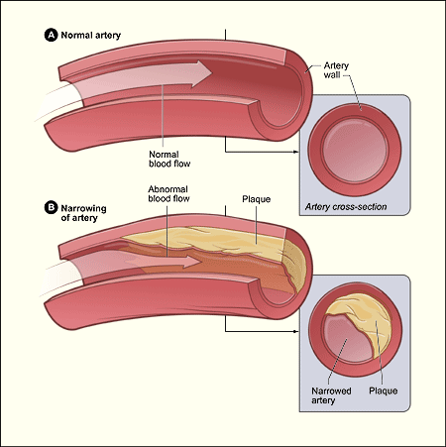
Lipid and Disease Risk – atherosclerosis

Slide 87
Lipid and Disease Risk – atherosclerosis
Plaque build-up in all vessels throughout body
Atherosclerosis leads to several disease types
Coronary heart disease
Kidney disease
Peripheral arterial disease
High blood pressure
Angina (chest pain)
Diabetes
Total occlusion of vessel or breakage of plaque
Results – heart attack, stroke, etc.
Ross, J. et al. Atherosclerosis and Cancer:Common Molecular Pathways of Disease Development and Progression. Annals of NY Academy of Sc. 2006

Slide 88
Cholesterol as Key Player in Atherosclerosis
Majority of lipid portion of plaque as LDL
Genetics – Familial hypercholesterolemia
Controlled by drugs and dietary restrictions
Distribution of cholesterol in HDL (good) and LDL (bad)
Higher HDL levels reduces cholesterol deposited in blood vessels by removing cholesterol from LDL
Exercise can increase HDL
Dietary changes to cholesterol - little impact on blood cholesterol
Synthesis of cholesterol is HIGHLY regulated – compensatory mechanisms kick in
McNamara, DJ. Dietary cholesterol and atherosclerosis. Biochim Biophys Acta. 2000 Dec 15;1529(1-3):310-20
Thompson PD. What do muscles have to do with lipoproteins? Circulation. 1990;81:1428–1430

Slide 89
Cholesterol – circulating levels
Normal circulating levels
LDL
<100 mg/dL– optimal
100 -129 mg/dL– suboptimal
HDL
Men: >40 mg/dL
Women: >50 mg/dL
Total Cholesterol
<200 mg/dL

Slide 90
Activity
Draw out pathway of:
chylomicron → VLDL→LDL
Include:
apolipoproteins involved and functions
Specific lipids it transports
Destination

Slide 91
Polyunsaturated Fatty Acids
Omega-6 (linoleic acid)
Omega-3 (alpha-linolenic acid)

Slide 92
Polyunsaturated Fatty Acids (PUFA)
PUFA - Essential fatty acids
Omega-6 (linoleic acid)
Omega-3 (alpha-linolenic acid)
Plants
Sources of omega-6 and -3 fatty acids
Marine animals
Fish – eat marine plants (contain omega-3)
Source of omega-3 derivatives – EPA and DHA
Poultry and Beef – grain fed (contain omega-6)
Source omega-6 derivatives

Slide 93
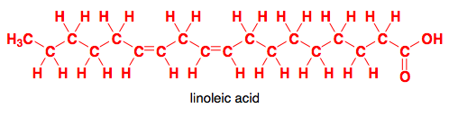
PUFA Metabolism
Omega-3 and -6 are 18 carbon FAs
Humans lack delta12 and delta15 desaturases
Cannot incorporate double bonds at omega-3 and -6 positions
Omega-6 → arachidonic acid → eicosanoids
(Omega-6)
Omega-3→ EPA → DHA
Eicosanoids

Slide 94
Polyunsaturated Fatty Acids (PUFA)
Omega-6 → arachidonic acid → eicosanoids
Omega-6
Most abundant in dietary sources
Sources:
Sunflower, Safflower, Corn, Sesame, soybean oils
Grains
Beef and poultry
Precursor of arachidonic acid (AA)
AA is precursor for eicosanoids
Role in: Blood clotting (increases) and Pro-Inflammatory response
Arachidonic acid role in:
Brain development
Adequate intake:
Women: 12 g/day
Men: 17 g/day
Average intake about 20-25 g/day

Slide 95
Polyunsaturated Fatty Acids (PUFA)
Omega-3→ EPA → DHA
Eicosanoids
Omega-3
Sources:
Marine vegetation – food source for fish
Soybean, flaxseed, canola oils
Precursor of EPA and DHA
EPA is precursor for eicosanoids
Eicosanoids role in: Blood clotting (decreases) and Anti-inflammatory response
EPA and DHA role in:
Neural and visual development and maintenance
Adequate intake:
Women: 1.1 g/day
Men: 1.6 g/day

Slide 96
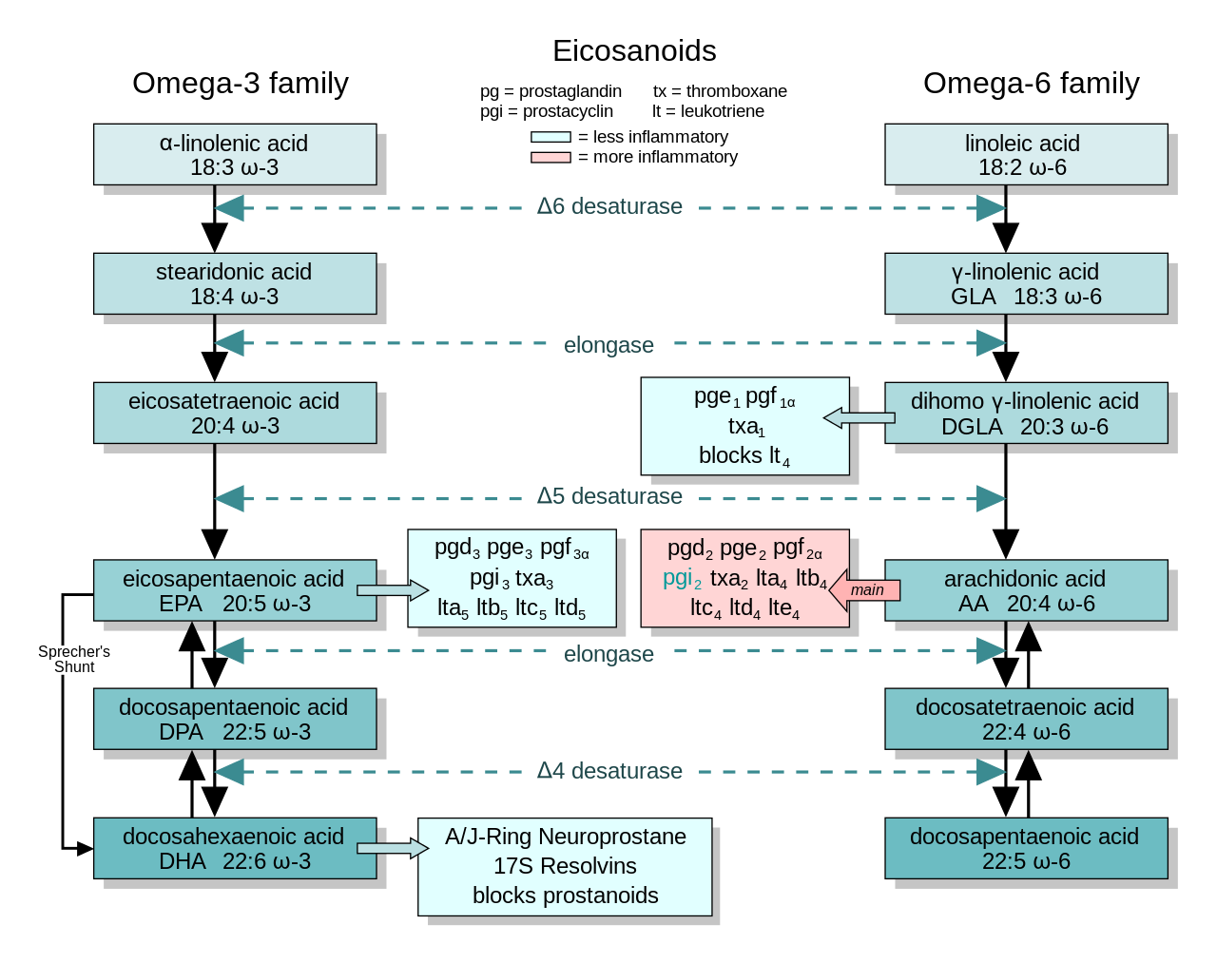

Slide 97
Polyunsaturated Fatty Acids (PUFA)
Eicosanoids: counteracting roles in body – ratio of Omega-6:Omega-3 FAs are highly studied
5:1 to 10:1
Example: 20 g of omega-6 with 2-4 g of omega-3
Typical suggestion: Decreased ratio = decreased disease risk
Omega-6 is abundant in westernized diet
High intake associated with adverse physiological outcomes
More prone to oxidation within body
Chronic inflammation – cancer, obesity, CVD, etc.
SM Grundy. AJCN. 1997; http://www.hsph.harvard.edu/nutritionsource/

Slide 98
Polyunsaturated Fatty Acids (PUFA)
Omega-3 conversion to EPA and DHA is inefficient
Competing for enzymes that metabolize omega-6
Highly recommended to take in sources of EPA and DHA (aka fish oils)
Livestock feed can be manipulated to increase or decrease these ratios
For example – exposure to different oils
SM Grundy. AJCN. 1997; http://www.hsph.harvard.edu/nutritionsource/

Slide 99
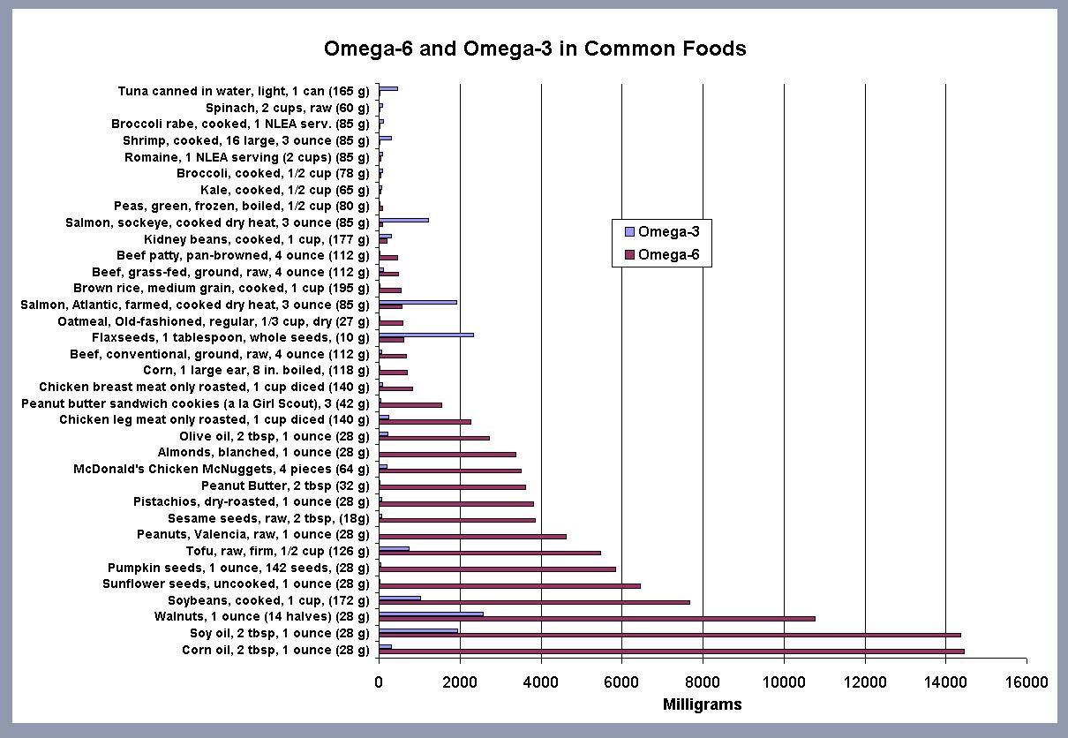
Polyunsaturated Fatty Acids (PUFA)

Slide 100
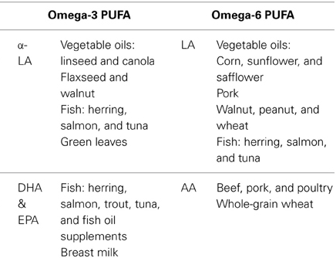

Slide 101
Summary
Cholesterol homeostasis is highly regulated on a daily basis
3 main steps to cholesterol synthesis
HMG CoA reductase is a highly regulated enzyme of cholesterol synthesis
LDL is main carrier of endogenous cholesterol through our bodies
LDLRs of many tissue types uptake LDL
Mutations of LDLR is highly prevalent and can result in high levels of circulating cholesterol
HDL rids free cholesterol from build-up
Cholesterol used to build other compounds
Omega-3 and -6 are essential fatty acids
Their derivatives have very important physiological roles in the body
Have counteracting roles in the body
Ratio of intake has implications health

